Slide 1


Slide 2
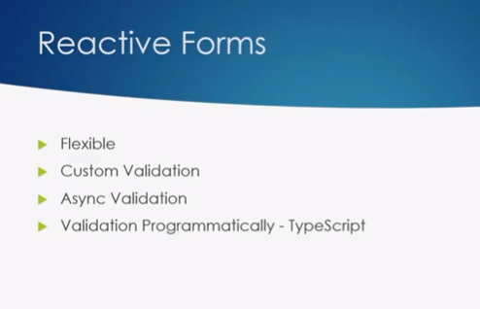
Angular Reactive Forms
Angular
55

Slide 3
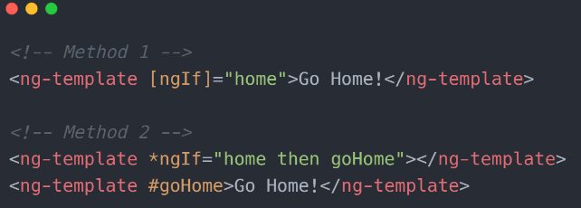
Angular <ng-template>
Angular
55

Slide 4
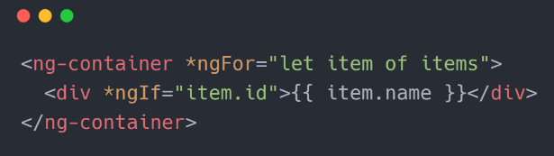
Angular <ng-container>
Angular
55

Slide 5
That’s All For Today Day-7 !!
Questions?

Slide 6
Thank You
shiva1991@live.com

